Slide 1

Revolutionizing Recruitments through
ONLINE
INTERVIEW
APPLICATION
Streamlining Interviews for the Digital Era at CLOUD COUNSELAGE Pvt. Ltd.
Santanu Ajit Maity, GGV/21/01157, 21027157, CSE 7th Semester

Slide 2


INTRODUCTION
The Evolution of Recruitment
The project aimed to develop an Online Interview Application that enhances the recruitment process in today’s digital landscape. With 92% of companies now incorporating online interviews, our solution integrates real-time video communication, automated scheduling, and secure data handling into a single, seamless platform, reducing time-to-hire by up to 50% and improve the overall candidate experience.
1990s
2000s
2010s
2020s
Traditional
Recruitment
Rise of
Online Job Portals
Adoption of
Video Interviews
Digital-FIrst
Recruitment Platforms
Manual scheduling, paper resumes, and in-person interviews were the norm, often hindered by geographic and logistical challenges.
Digital job applications became possible, but interviews were still largely conducted in person, with manual processes prevailing.
Video conferencing tools reduced the need for travel, allowing global connections, though they lacked integration with broader systems.
Modern platforms integrate real-time video, scheduling, and secure data management, making the recruitment process efficient and accessible globally.

Slide 3

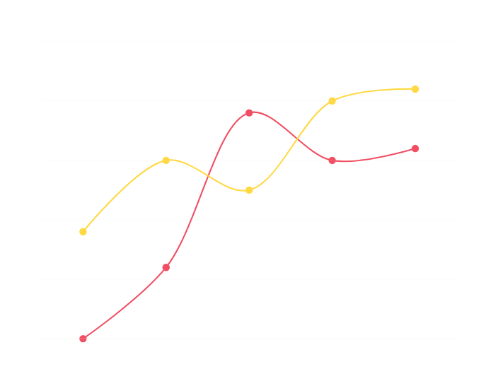
PROBLEM STATEMENT
The Challenges in Traditional Interview Processes
Traditional interviews are plagued by logistical challenges, inefficiencies, and security concerns. 60% of hiring delays are due to scheduling conflicts and geographic barriers, while 75% of companies report concerns about data security during interviews, underscoring the need for a more efficient and secure interview platform.
SPEND TIME ON HIGH VALUE TASKS
WHY TRADITIONAL INTERVIEWS FAILED?
Candidate
attraction
Candidate
evaluation
Effort & expense
Employee
onboarding
63% | Assessing candidate soft skills
New way
58% | Understanding candidate weaknesses
Old way
42% | Bias of Interviews
36% | Too long of a process
Hiring Process

Slide 4

METHODOLOGY
From Concept to Creation: Building the Foundation
REQUIREMENT ANALYSIS
SYSTEM DESIGN
TECHNOLOGY SELECTION
Stakeholder Identification,
Functional Requirements Gathering
Architectural Design (Backend - Flask, Frontend - Bootstrap, Database - PostgreSQL), UI/UX Design
Backend: Flask Frontend: Bootstrap, JavaScript Database: PostgreSQL/MySQL, Storage: AWS S3
DEPLOYMENT
TESTING UNIT
DEVELOPMENT
CI/CD Setup: Jenkins/GitHub
Actions Environment Setup: AWS EC2
Instances Deployment: Application Live
Unit Testing: Pytest
Integration Testing: Postman, Selenium
User Acceptance Testing (UAT): User Feedback Integration
Backend Development: Flask API, Database Integration
Frontend Development: Bootstrap UI, JavaScript Functionality API Integration: RESTful API Development
MAINTENANCE
Monitoring: AWS CloudWatch
Bug Fixes: Regular Updates
Enhancements: Feature Additions

Slide 5


IMPLEMENTATION
Achieving Seamless Integration
BACKEND & API DEVELOPMENT
BACKEND DEVELOPMENT
Flask Framework: The backend is built using Flask, handling server-side logic such as user authentication, session management, and database interaction.
Database Integration (PostgreSQL/MySQL): SQLAlchemy ORM is used to integrate the relational database, simplifying operations by mapping Python objects to database tables.
RESTful API Development: Flask is used to create RESTful APIs for core features like user login, interview scheduling, and data retrieval, enabling smooth communication between the frontend and backend.
FILE STORAGE
AWS S3 securely stores interview recordings, documents, and files with encryption, . Boto3, the AWS SDK for Python, is used to manage file uploads and downloads programmatically.

Slide 6

IMPLEMENTATION
Continued.....
FRONTEND DEVELOPMENT &
INTEGRATION
FRONTEND DEVELOPMENT
Bootstrap Framework: Bootstrap is used to create a responsive, intuitive UI across devices, with HTML, CSS, and JavaScript handling forms, navigation, and interactive elements.
JavaScript & AJAX: JavaScript enhances user interactions, while AJAX allows asynchronous content updates without page reloads, improving user experience.
API INTEGRATION
The frontend communicates with the backend via AJAX, sending and receiving data through API calls for real-time updates like interview scheduling and data retrieval.

Slide 7
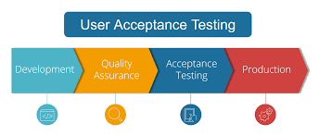
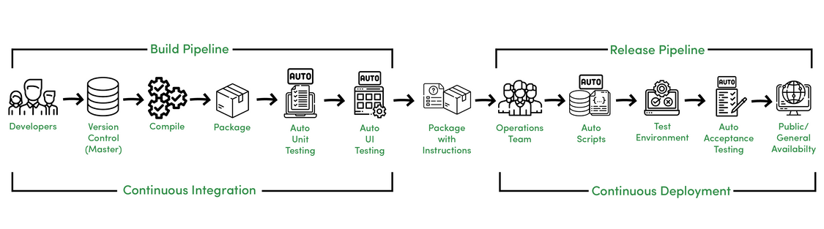
IMPLEMENTATION
Continued.....
TESTING, DEPLOYMENT & MAINTENANCE
TESTING
Unit Testing (Pytest): Pytest ensures backend components like API responses and database queries function correctly.
Integration Testing (Postman): Postman simulates API calls to test interactions between the frontend and backend.
User Acceptance Testing (UAT): Real users test the application, providing feedback for adjustments.
DEPLOYMENT & MAINTENANCE:
CI/CD Pipeline (Jenkins/GitHub Actions): Automated deployment ensures continuous updates and integration on AWS EC2 instances.
Monitoring & Maintenance (AWS CloudWatch): CloudWatch tracks performance, logs errors, and provides metrics for ongoing updates, bug fixes, and feature improvements.

Slide 8


CHALLENGES & SOLUTION
Broadening the Horizon
Challenge 1: Secure storage and transmission of sensitive data.
Challenge 2: Handling large video files and ensuring smooth streaming.
SOLUTIONS
AES, HTTPS, AWS S3
Multipart Upload , Adaptive Bitrate Stream
Responsive Web D
UCD, Simplified UI
Challenge 4: Managing scalability during high traffic periods.
Challenge 3: Ensuring compatibility across browsers and devices.

Slide 9
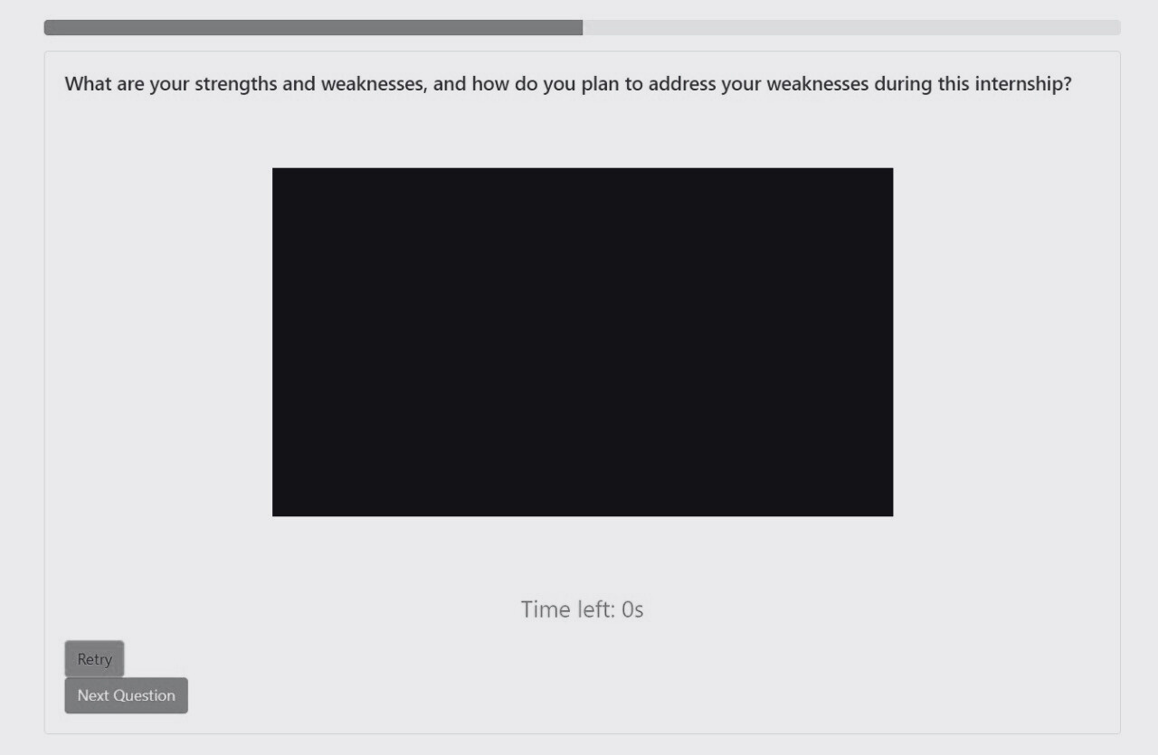

RESULTS
Performance and User Experience Metrics
REAL-TIME INTERVIEW EXPERIENCE
ENHANCED USABILITY
The application simulates a real interview by enforcing a 5-second pause before each question, followed by 30 seconds for candidates to respond.
The responsive design using Bootstrap led 95% of users finding the interface intuitive and easy to navigate and increasing user engagement
SEAMLESS VIDEO STREAMING
SECURE DATA MANAGEMENT
Integration with AWS CloudFront reported a 20% reduction in buffering and smoother video playback, even in low bandwidth conditions.
By leveraging AES 256-bit encryption no security breaches were reported, with 100% compliance to data security protocols
figure: Application Window

Slide 10
FUTURE SCOPES
Scaling further endeavours
Integrate advanced AI for deeper feedback on candidates’ performance and develop AI-powered scheduling tools for streamlined interview coordination.
Add features for seamless connections with job portals and applicant tracking systems, and collaborate with educational institutions for real-time interview practice.
Support multiple languages and enhance accessibility features to cater to a global and diverse user base, including those with disabilities.
Implement cloud-based solutions for scalability and optimize performance for faster load times and better user engagement.
Enhanced AI Capabilities
Platform Integration
Expanded Accessibilitym
Scalability Improvements

Slide 11
CONCLUSION
Reflections and final remarks
The development and deployment of our ONLINE INTERVIEW APPLICATION represent a successful fusion of technology, usability, and security. As an INTERN on this project, I witnessed how our team effectively created a realistic, user-friendly, and reliable tool for interview preparation. We overcame various challenges to deliver an application that meets modern interviewing needs with sophistication and efficiency.
Looking forward, we plan to enhance the application with AI-driven simulations, real-time feedback features, and advanced data security. These future improvements will ensure our tool remains cutting-edge, adapting to evolving user needs and industry standards. This project has been a remarkable experience, reflecting our commitment to innovation and excellence in interview technology.

Slide 12
THANK YOU
for your time and attention

